Slide 1
Multimodal Emotion Recognition from Eye Movement and EEG
0226594 || Sara Carolina Gómez Delgado

Slide 2


Slide 3

Problem

Slide 4


Classify different types of emotions based on human brain waves and eye movements.
Sad
Happy
Disgust
Neutral
Fear

Slide 5

Applications

Slide 6
01
02
Understanding Emotions
Diagnosis Purposes
Psychiatry and Psychology
Relationship between emotions, EEG and eye movement.
04
03
Affective Computing Technologies
Therapeutic Purposes
Evaluate treatments effectiveness
Human-computer interaction

Slide 7

Related Work

Slide 8
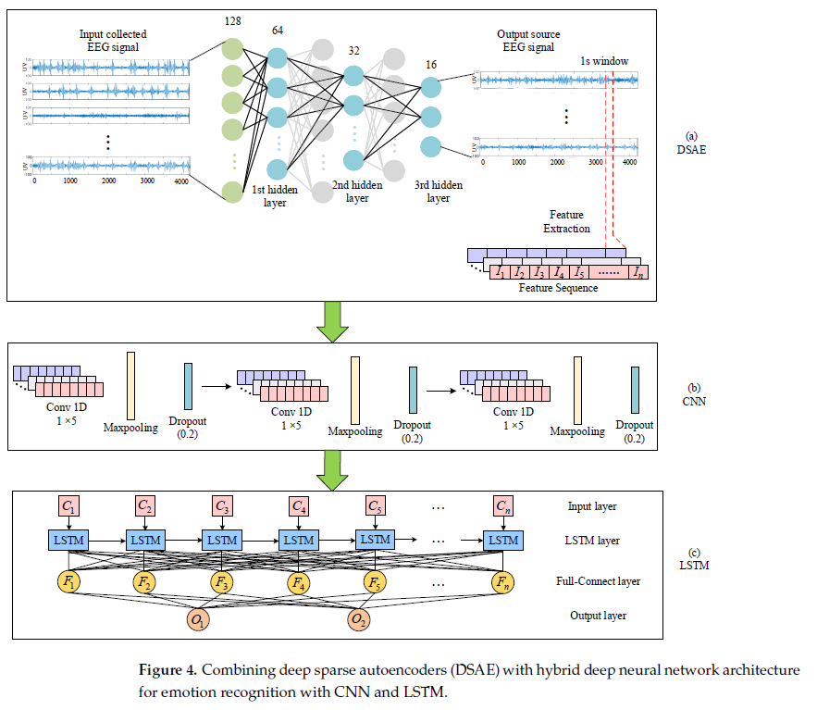
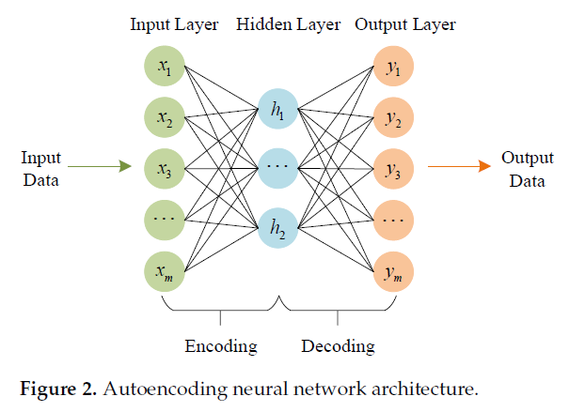
Deep Sparse Autoencoder and Recursive Neural Network for
EEG Emotion Recognition
Hybrid Neural Network Methods
Sparse Autoencoder (SAE)

Slide 9
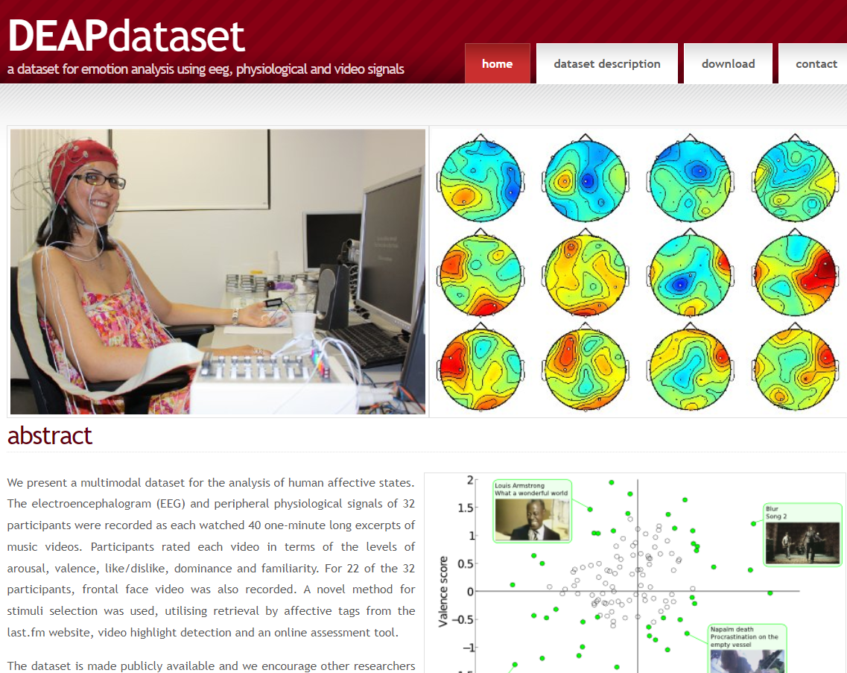
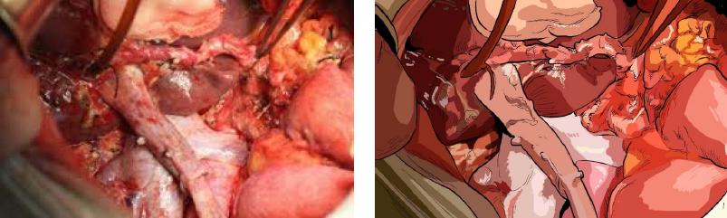
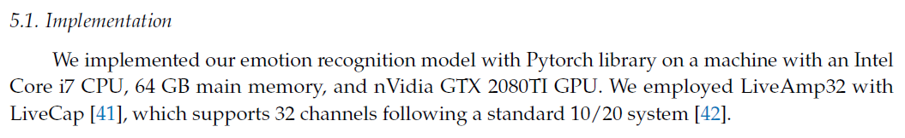
Reduction of Negative Emotions for Illustrated Surgical Images
CNN
Large number of parameters and a long training time.

Slide 10

SEED-V
Shanghai Jiao Tong University

Slide 11
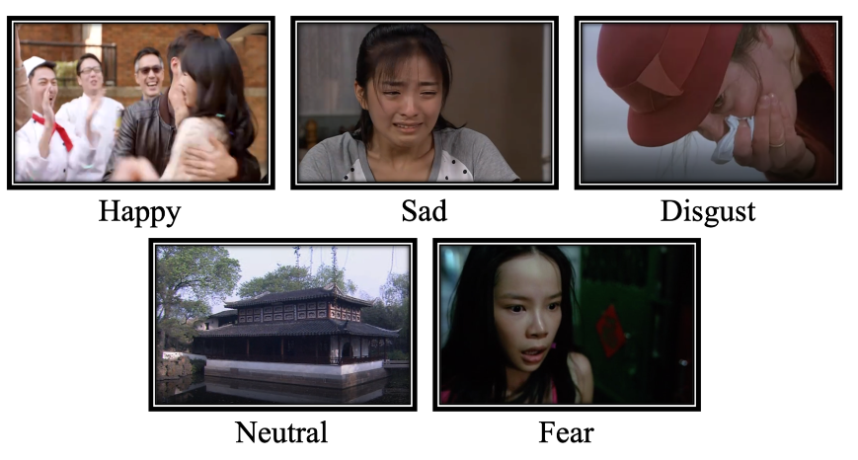
Important Data
EEG features
01
02
EEG_raw
Features of 16 participants
Data collected with Neuroscan device
Emotion label and stimuli order
04
03
Eye_raw
Experiments’ order
Blink duration, Average Pupil Size, etc.

Slide 12





Dataset Emotion Labels
0. Disgust
1. Fear
2. Sad
3. Neutral
4. Happy

Slide 13
EEG and Eye Tracking Data
15 clips per session = 45 feature matrix

Slide 14

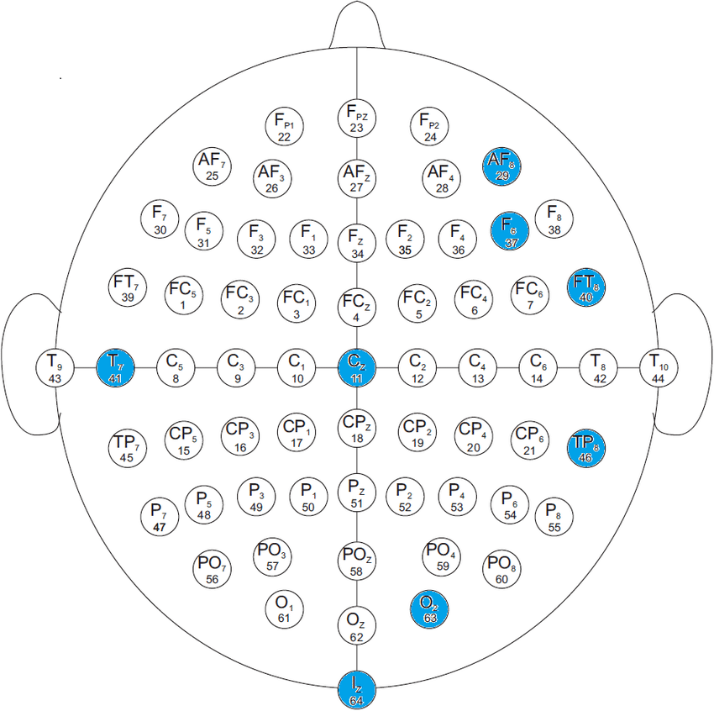
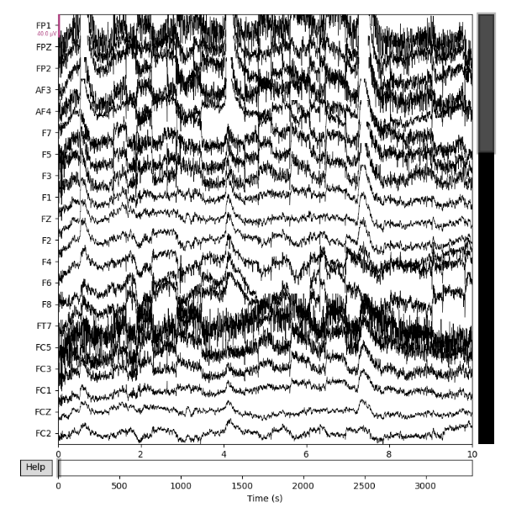
Electrode capturing brainwave activity
Channels visualization

Slide 15
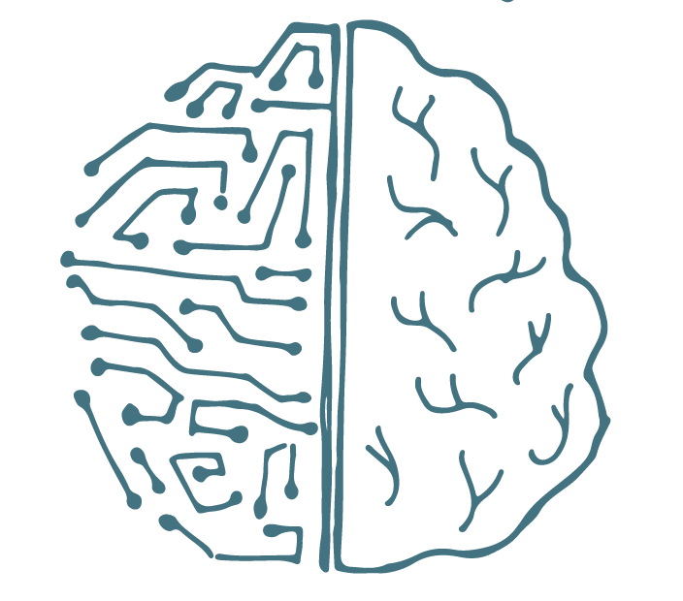
Architecture
(RNN type)

Slide 16
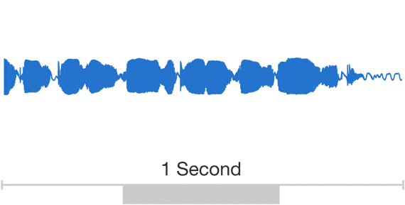
WaveNet
A Deep Generative model of raw audio waveforms.

Slide 17
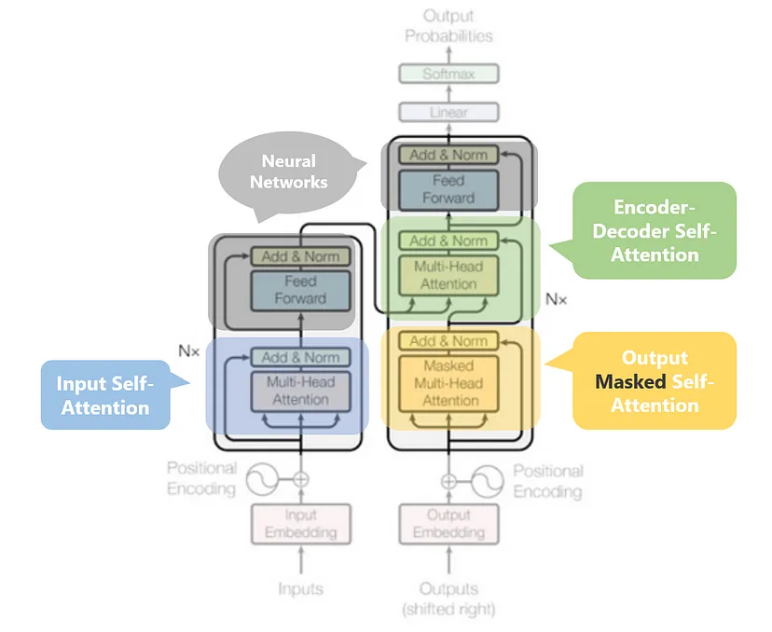
Transformers
Used primarily in the fields:
Natural Language Processing (NLP)
Computer Vision (CV)

Slide 18


Long Short-Term Memory (LSTM)
LSTM can process not only single data points (such as images), but also entire sequences of data (speech or video)

Slide 19
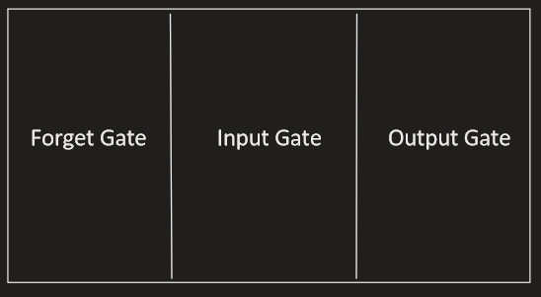
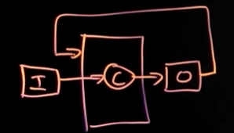
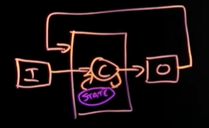
Anatomy of LSTM
RNN
LSTM
Internal state (LSTM cell)
0-1
0-1
0-1

Slide 20

Long Short-Term Memory
Can choose what to remember

Slide 21

Long Short-Term Memory
Designed to remember patterns over extended periods

Slide 22
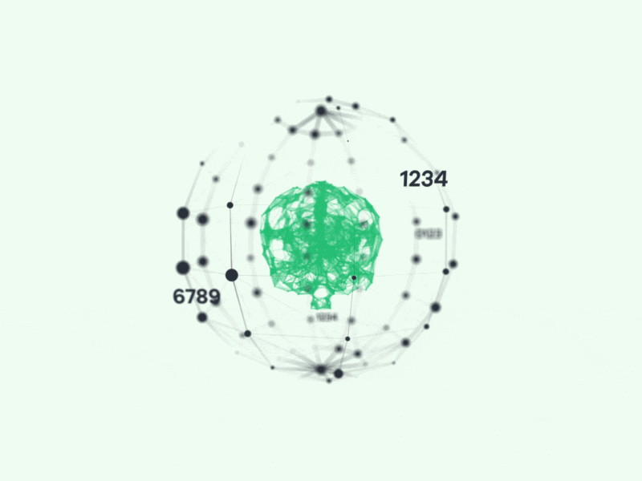
Long Short-Term Memory
It focus on the most relevant and important data.

Slide 23

Data processing

Slide 24
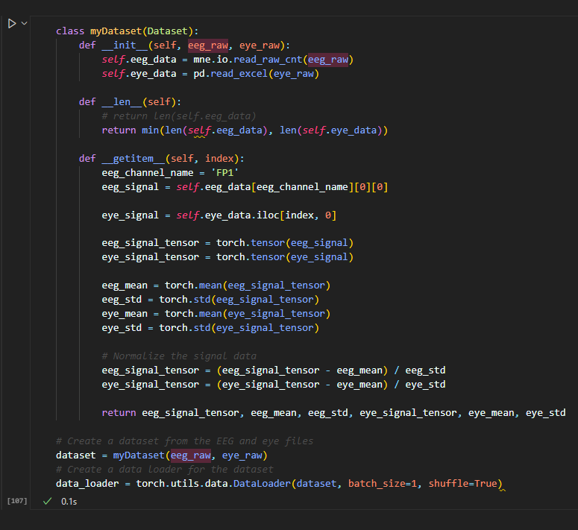
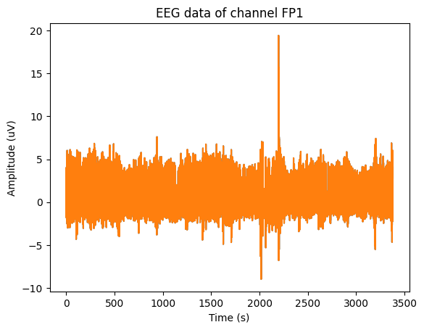
Dataloader

Slide 25



